Slide 1
mydas: MSY for DAta-limited Stocks
Hans Gerritsen (MI); Cóilín Minto, Laurence Kell, Alexander Tidd (GMIT)

Slide 2
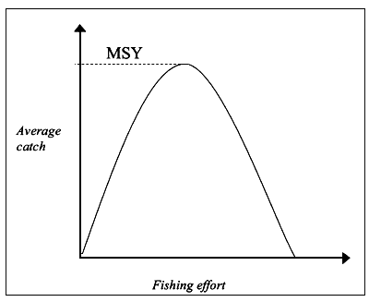
Maximum Sustainable Yield (MSY)
MSY is the optimum catch:
Too much and the stock will decline
Too little is missed revenue
Common Fisheries Policy: achieve MSY for all harvested species
Marine Strategy Framework Directive: Good Environmental Status descriptors D3
Need to estimate reference points:
Which fishing mortality gives the highest long-term yield (F_{MSY})
The minimum stock size that is still at full reproductive capacity (B_{lim})
Data hungry: full analytical assessment

Slide 3
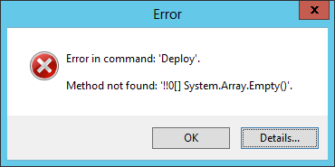

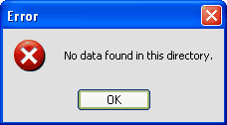

Data-poor stocks
Ireland has quota for 72 fish stocks; 26 of these have unknown MSY status
Most of the non-quota stocks also have unknown MSY status
Many of these are keystone species and/or sensitive to the impacts of fishing

Slide 4
MSY targets for data-poor stocks
MYDAS project:
Case studies across the spectrum of data-limited stocks
Develop methods to assess the status of these stocks relative to MSY reference points
Develop management strategies
Test the assumptions and performance of the methods and management strategies
Build a common framework for modelling and simulation

Slide 5

Where to start?
Robin hood approach: steal from the (data)rich and give to the (data)poor
Use life-history parameters from neighbouring stocks of the same species

Slide 6

Management Strategy Evaluation
Estimate (or steal) life-history parameters (growth, natural mortality, maturity, stock-recruit curve)
Build an operating model: a virtual fish stock
Management Strategy Evaluation

Slide 7



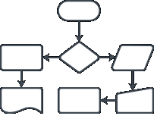

Management Strategy Evaluation
Operating model
Simulated fish stock
Observation error
Simulate data collection
Catch
TAC, effort
Harvest rule
Catch advice
Assessment model
Reference points
Stock status

Slide 8
Management Strategy Evaluation
Management Strategy Evaluation (MSE)
Which harvest rules (management strategies) work well?
Different approaches for different types of stock and data availability.
What is the most important information? (survey, catch, life-history)
Adapt future data collection

Slide 9
Project outputs
Completed:
Assessment models and tools implemented in one framework
Methods for estimating reference points and management strategy evaluations
Contributions to relevant ICES working groups
Publications
Planned:
General: which rules work well for which classes of stocks and data availability?
Specific stocks: proposed reference points and management strategies
Follow-up project:
Practical implementation

Slide 10
Expected benefits
Improved metrics to support the CFP and MSFD
Improved management strategies for data-poor stocks
Improved knowledge of the dynamics of data-poor stocks
Improved understanding of the impact of fishing on the wider ecosystem

Slide 11
Where to start?
Robin hood approach
Steal from the (data)rich and give to the (data)poor

Slide 12

Where to finish?
Sheriff of Nottingham approach
Steal from the (data)poor and give to the (data)rich
Some of the data-poor approaches might be more robust than the data-rich approaches

Slide 13
End
Project wiki: https://github.com/laurieKell/mydas/wiki

